Slide 1
Magnetic circuits in Motors
The above is clearly a good magnetic circuit, but without conductors on the rotors we will not get torque.
Current carrying conductors around the rotor generate BiL force for each wire.
Torque is Force times radius.

Slide 2
Slotting
Conductors lying on the rotor increase the air gap, increasing reluctance and reducing the flux.
They also have to be secured to the rotor to transmit their force.
Slotting solves both of these problems. While still allowing the conductors to cut the field lines (though it doesn’t look like it).
Now however we must balance current density (limited to 2-8 A/mm²) and flux density (limited to ~1.5 T). We want as much copper as possible and we want as much iron as possible.

Slide 3
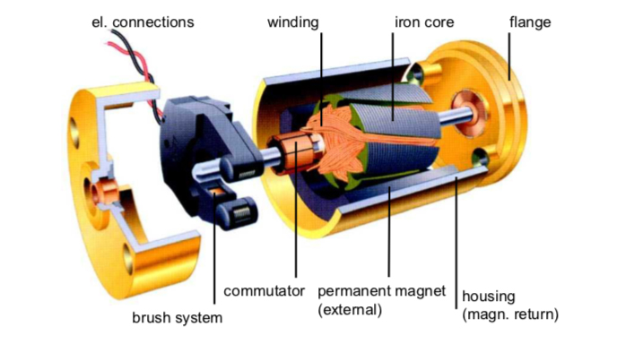
In a Permanent Magnet Direct Current (PMDC) motor:
electric current is directed through brushes and a commutator to coils on the rotor.
The rotor is comprised of magnetic steel with copper windings
A small air-gap exists between the rotor and the permanent magnets of the stator. A steel casing forms a yoke to complete the magnetic circuit.

Slide 4
Toward a useful mathematical model: Consider An Elementary Motor
Conductor has resistance R, carries a current I and moves with velocity v. The string is connected to a mass.
Notes:
Tension = mg = BIL or I = mg/BL. Here we see that the current in the conductor is determined by the mechanical load

Slide 5
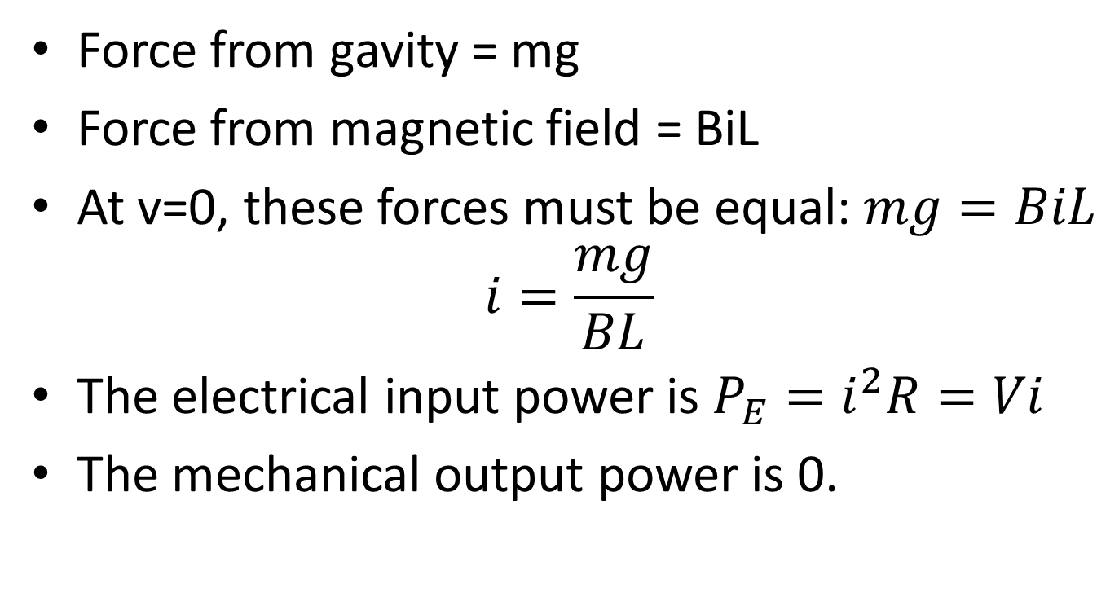
At v=0, what are the pulling force, current, electrical input power, and mechanical output power?
Force from gavity = mg
Force from magnetic field = BiL
At v=0, these forces must be equal: $mg=BiL$
$$i=\frac{mg}{BL}$$
The electrical input power is $P_{E}=i^{2}R=Vi$
The mechanical output power is 0.

Slide 6
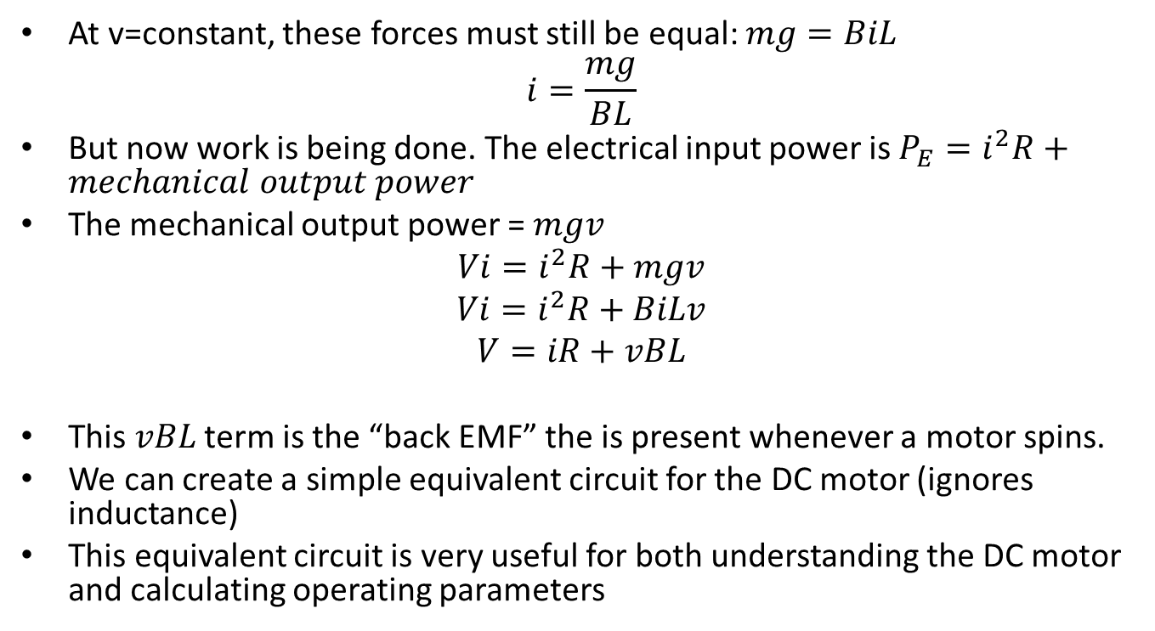
At v=constant, what are the pulling force, current, electrical input power, and mechanical output power?
At v=constant, these forces must still be equal: $mg=BiL$
$$i=\frac{mg}{BL}$$
But now work is being done. The electrical input power is $P_{E}=i^{2}R+mechanical output power$
The mechanical output power = $mgv$
$$Vi=i^{2}R+mgv$$
$$Vi=i^{2}R+BiLv$$
$$V=iR+vBL$$
This $vBL$ term is the “back EMF” the is present whenever a motor spins.
We can create a simple equivalent circuit for the DC motor (ignores inductance)
This equivalent circuit is very useful for both understanding the DC motor and calculating operating parameters

Slide 7
Equivalent circuit
DC motors have a simple equivalent circuit, includes back emf: E.
If E is less than V, current will be positive and power will flow from electrical to mechanical form.
E is proportional to speed, related by the electrical constant K_{E}:
E = K_{E} ω
Then: V_{applied} = RI + K_{E}ω
If we spin the motor fast enough such that E is larger than V, then the current will reverse and mechanical power will be converted to electrical power. Called generating.
Notes:
“w” or lower case ohmega is the symbol for speed in rad/s

Slide 8
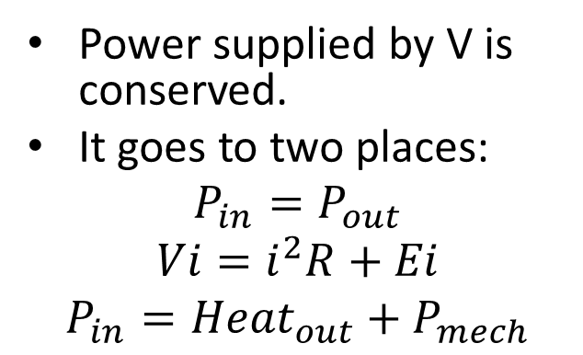
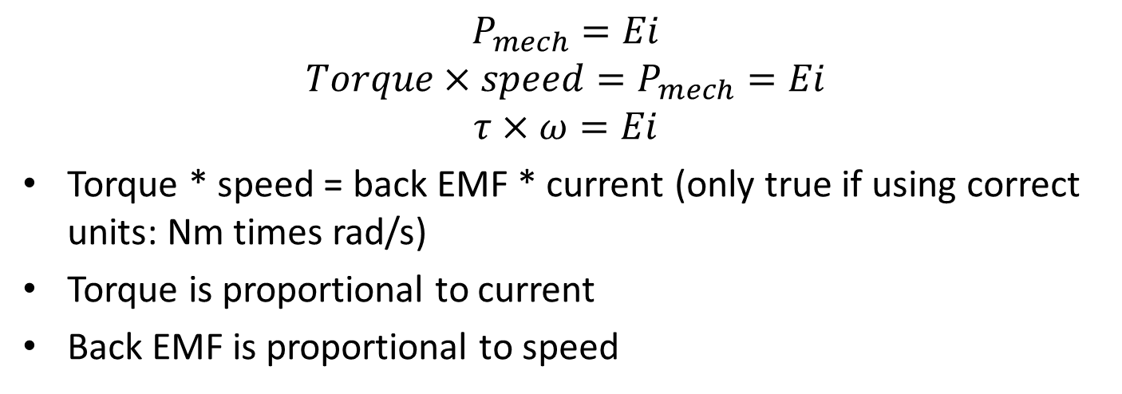
Mechanical Output Power
Power supplied by V is conserved.
It goes to two places:
$$P_{in}=P_{out}$$
$$Vi=i^{2}R+Ei$$
$$P_{in}={Heat}_{out}+P_{mech}$$
$$P_{mech}=Ei$$
$${Torque×speed=P}_{mech}=Ei$$
$$τ×ω=Ei$$
Torque * speed = back EMF * current (only true if using correct units: Nm times rad/s)
Torque is proportional to current
Back EMF is proportional to speed
Notes:
“w” or lower case ohmega is the symbol for speed in rad/s

Slide 9
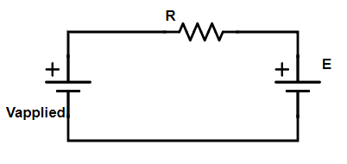
The ideal PM DC model
The Back EMF (E) is proportional to speed (electrical constant)
K_{E} = back EMF divided by speed
If we ignore friction then applied voltage divided by no load speed
The no load speed is the speed that the motor spins, when the back EMF equals the applied voltage.
The no-load speed is proportional to voltage.
No current will flow at no-load speed
Torque is proportional to current (motor constant or torque constant)
K_{T} = Stall torque divided by stall current at any applied voltage
At stall, the back EMF is 0. Current is limited only by the terminal resistance (resistance of the copper windings).

Slide 10
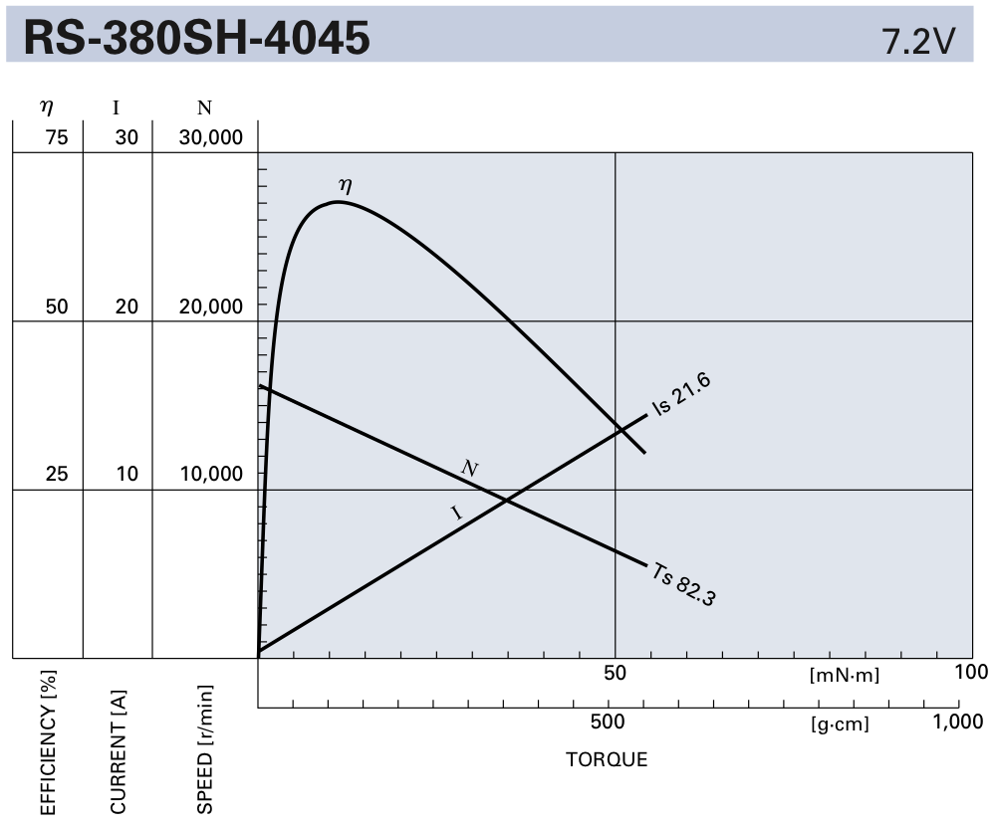
PM DC Motor Torque Speed Curve
Voltage
Notes:
You will find that data sheets use a wide range of torque units. You will need to be able to convert them fluently without google.

Slide 11
Maxon Motor Tutorials
Watch the three videos on ilearn from Maxon Motors
Chapter 1: Motor Data and Operating Ranges
Chapter 2: Speed vs Torque
Chapter 3: Windings

Slide 12
Example Questions
Using the example data sheet given a few slides back for a permanent magnet DC motor.
a) What is the stall torque in Nm?
b) What is the stall current?
c) What is the no load speed in Hz and rad/s?
d) Determine the current, back EMF, and torque at half the no load speed?
e) Estimate the efficiency at this speed.
f) What is the torque constant K_{T} and electrical constant K_{E}? Be sure to give appropriate units. K_{T} [Nm/A], K_{E} [Vs/rad]
Notes:
a) 0.083 Nm, b) 21.6 A, c) 267 Hz, 1675 rad/s d) 10.8 A, 3.6 V, 41.2 mNm, e) 40%, f) KT = 0.0038 Nm/A, KE = 0.0043 Vs/rad

